Slide 1
Chapter 10
Monitoring and Information Systems

Slide 2
Terms
Monitoring - Collecting, recording, and reporting information concerning any and all aspects of project performance
Controlling - Uses the data supplied by monitoring to bring actual performance into compliance with the plan
Evaluation - Judgments regarding the quality and effectiveness of project performance
10-<number>

Slide 3
The Planning–Monitoring–Controlling Cycle
We mainly want to monitor:
  Time (schedule)
  Cost (budget)
  Scope (project performance)
    Becoming more important as projects are increasingly complex
Closed-loop system
  Revised plans and schedules following corrective actions
10-<number>

Slide 4
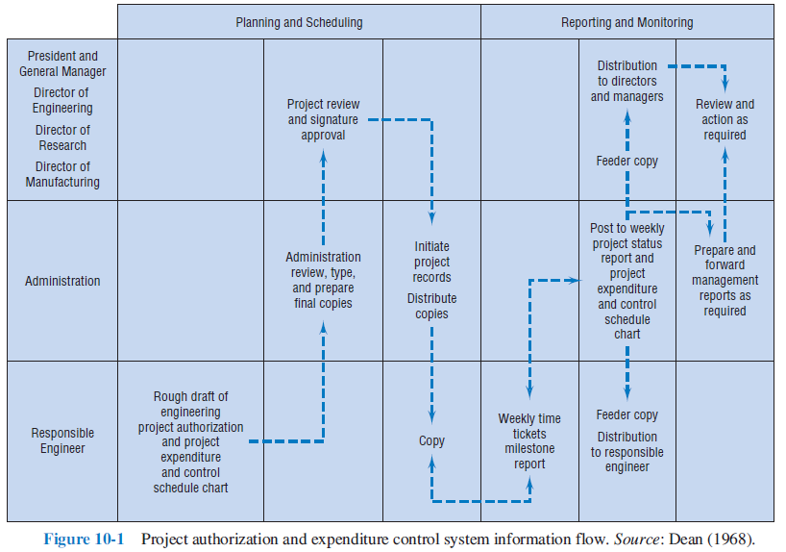
Project Authorization and Expenditure Control System Information Flow
10-<number>

Slide 5
Designing the Monitoring System (Slide 1 of 2)
Identify key factors to be controlled
  Scope
  Cost
  Time
Information to be collected must be identified
10-<number>

Slide 6
Designing the Monitoring System (Slide 1 of 2)
Do not want to avoid collecting necessary data because it is hard to get
Do not want to collect too much data
The next step is to design a reporting system that gets the data to the proper people in a timely and understandable manner
10-<number>

Slide 7
Five Telltale Signs of Project Trouble
Muddy waters
Mysterious stakeholders
Unconstrained constraints
Suspicious status reports
Discord and drama
10-<number>

Slide 8
Information Needs and Reporting
Everyone should be tied into the reporting system
Reports should address each level
Not at same depth and frequency for every level
  Lower-level needs detailed information
  Senior management levels need overview reports
Report frequency is typically high at low levels and less frequent at higher levels
10-<number>
Notes:
Everyone concerned with the project should be appropriately tied into the project reporting system. The monitoring system ought to be constructed so that it addresses every level of management, but reports need not be of the same depth or at the same frequency for each level. Lower-level personnel have a need for detailed information about individual tasks and the factors affecting such tasks. Report frequency is usually high. For the senior management levels, overview reports describe progress in more aggregated terms with less individual task detail unless senior management has a special interest in a specific activity or task. Reports are issued less often. In both cases, the structure of the reports should reflect the work breakdown structure, with each managerial level receiving reports that allow the exercise of control at the relevant level.

Slide 9
The Reporting Process
Reports must contain relevant data
Must be issued frequently
Should be available in time for control
Distribution of project reports depends on interest
  For senior management, may be few milestones
  For project manager, there may be many critical points
10-<number>
Notes:
The relationship of project reports to the project action plan or work breakdown structure is the key to the determination of both report content and frequency. Reports must contain data applicable to the control of specific tasks that are being carried out according to a specific schedule. The frequency of reporting should be great enough to allow control to be exerted during or before the period in which the task is scheduled for completion. In addition to the criterion that reports should be available in time to be used for project control, the timing of reports should generally correspond to the timing of project milestones.
The distribution of project reports depends on who is interested. For senior management, there may be only a few milestones, even in large projects. For the project manager there may be many critical points in the project schedule at which major decisions must be made, large changes in the resource base must be initiated, or key technical results achieved. Similar points relevant to lower levels relate to finer detail and occur with higher frequency.

Slide 10
Benefits of Detailed and Timely Reports
Mutual understanding of the goals
Awareness of the progress of parallel activities
Understanding the relationship of tasks
Early warning signals of problems
Minimizing the confusion
Higher visibility to top management
Keeping client up to date
10-<number>

Slide 11
Report Types
Routine - Reports that are issued on a regular basis or each time the project reaches a milestone
Exception - Reports that are generated when an usual condition occurs or as an informational vehicle when an unusual decision is made
Special Analysis - Reports that result from studies commissioned to look into unexpected problems
10-<number>

Slide 12
Meetings
Reports do not have to be written
They can be delivered verbally in meetings
Projects have too many meetings
The trick is to keep them to as few as possible
10-<number>

Slide 13
Meeting Rules
Use meetings to make group decisions
Start and end on time and have an agenda
Do your homework before the meeting
Take minutes
Avoid attributing remarks to individuals in minutes
Avoid overly formal rules of procedure
Call meeting for serious problems
10-<number>

Slide 14
Common Reporting Problems
Too much detail
Poor interface between the data/procedures of the project and the information system of the parent company
Poor correspondence between the planning process and the monitoring process
10-<number>

Slide 15
Earned Value Analysis
Have covered monitoring parts
  Timing and coordination between individual tasks is important
Must also monitor performance of entire project
  Crux of matter should not be overlooked
One way is by using an aggregate performance measure called earned value
10-<number>

Slide 16
The Earned Value Chart and Calculations
Actual against baseline ignores the amount of work accomplished
Earned value incorporates work accomplished
Multiply the estimated percent work complete for each task by the planned cost
Only need percent complete estimate for tasks currently in progress
10-<number>

Slide 17
Rules to Aid in Estimating Percent Completion
50-50 rule
0-100 percent rule
Critical input use rule
Proportionality rule
10-<number>

Slide 18
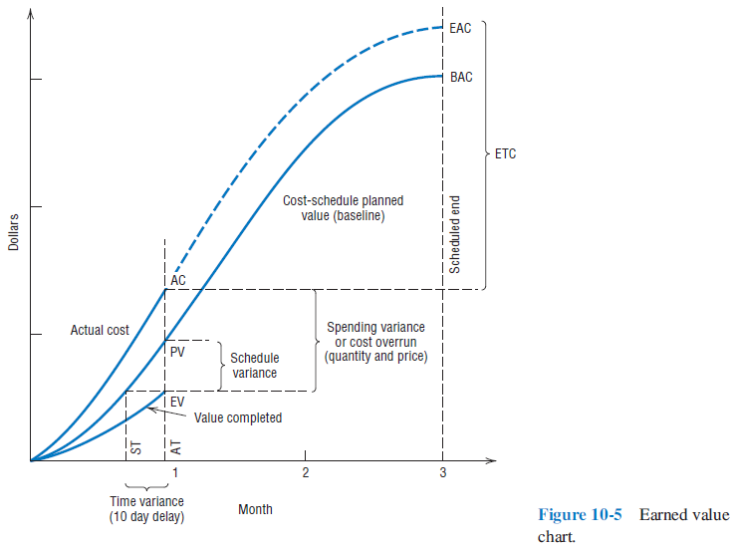
The Earned Value Chart
10-<number>

Slide 19
Variances
Variances can help analyze a project
  A negative variance is bad
  Cost and schedule variances are calculated as the earned value minus some other measure
Will look at some of the more common ones
10-<number>

Slide 20
Cost Variance (CV)
CV = EV – AC
Negative variance indicates a cost overrun
Magnitude depends on the costs
10-<number>

Slide 21
Schedule Variance (SV)
SV = EV – PV
Negative variance indicates you are behind schedule
Measured using costs
10-<number>

Slide 22
Time Variance (TV)
TV = ST – AT
Negative variance indicates you are behind schedule
10-<number>

Slide 23
Indices
Cost Performance Index
CPI = EV/AC
Schedule Performance Index
SPI = EV/PV
Time Performance Index
TPI = ST/AT
Cost Schedule Index
CSI = EV²/(AC)(PV)
10-<number>

Slide 24
“To complete” and “At Completion”
Project manager reviewing what is complete and what remains
Final cost and final completion date are moving targets
The project manager compiles these into a to complete forecast
Actual + forecast = final date and cost at completion
10-<number>

Slide 25
ETC and EAC
ETC = (BAC + EV)/CPI
EAC = ETC + AC
where,
  ETC = Estimated cost to complete
  BAC = Budget at completion
  EV = Earned value
  CPI = Cost performance index
  EAC = Estimated cost at completion
  AC = Amount expended to date (actual cost)
10-<number>

Slide 26
Milestone Reporting
Reports that are created when a project reaches a major milestone
They are designed to keep everyone up-to-date on project status
For executives and clients, these may be the only reports they receive
10-<number>

Slide 27
Burnup and Burndown Charts (Slide 1 of 2)
Especially popular with agile development
For monitoring and communicating overall project progress.
Scope is on the vertical axis
Time is on the horizontal axis
10-<number>

Slide 28
Burnup and Burndown Charts (Slide 2 of 2)
Burndown charts:
  The remaining work to be completed it included
Burnup charts:
  Include two plotted lines
    Amount of work completed to date
    Total amount of work to be completed
10-<number>

Slide 29
Copyright
Copyright © 2018 John Wiley & Sons, Inc.
All rights reserved. Reproduction or translation of this work beyond that permitted in Section 117 of the 1976 United States Act without the express written permission of the copyright owner is unlawful. Request for further information should be addressed to the Permissions Department, John Wiley & Sons, Inc. The purchaser may make back-up copies for his/her own use only and not for distribution or resale. The Publisher assumes no responsibility for errors, omissions, or damages, caused by the use of these programs or from the use of the information contained herein.
Copyright ©2018 John Wiley & Son, Inc.

